Slide 1
Unit 1-Definition

Slide 2
Definition of AI
Different attempts were made to define what is Artificial Intelligence.
Defining even simple things difficult at times.
Measure of Human Intelligence: IQ test
There are different definitions of AI in Literature.
We have already seen this
AI: attempts to understand and build intelligent entities.
John McCarthy, who coined the term in 1956, defines it as "the science and engineering of making intelligent machines."

Slide 3
Definitions

Slide 4
The definitions on top are concerned with thought processes and reasoning
Ones on the bottom address action or behavior.
Ones the left measure success in terms of fidelity to human performance
Ones on the right measure against an ideal performance measure, called rationality.
A system is said to be rational if it does the “right thing,” given what it knows.
All four approaches of AI have been followed.
Which is the right definition?

Slide 5
Thinking Humanly:
How to determine how Humans think?
Through introspection and some psychological experiments.
Question here is do we want to built machine that beats humans in chess, or which think like Garry Kasparov?
Thinking like humans is important in cognitive science
We don’t want AI machines to take decisions emotionally
Understanding emotions and human behavior can be important is some applications where AI can take help from cognitive science or psychology.
So, thinking humanly is not an appropriate definition

Slide 6
Thinking Rationally:
How to think Rationally?
What is the correct thought process?
How to take logical decisions?
When correct premises are given how to get the correct conclusion.
e.g.Socrates is a man, All men are mortal, so Socrates is mortal.
All intelligent behavior cannot be explained by logic
Reflex actions
Logical reasoning not required for all AI machines but is an intelligent behavior to have for Robotic Applications.
Not an appropriate definition as per many researchers

Slide 7
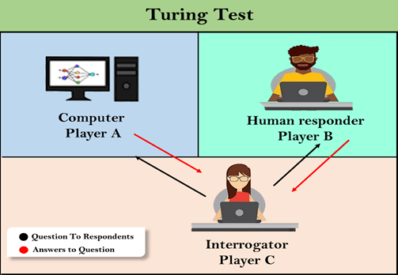
Acting Humanly:
How to act like humans?
Analyzed using Turing test
Capabilities to qualify the test:
NLP
Knowledge Representation
Automated Reasoning
Machine Learning
Computer Vision
Robotics
All six disciplines compose most of AI
We don’t want the machines to make spelling mistakes while answering questions, to be like humans to win the test

Slide 8
Acting Rationally:
A more appropriate definition for AI will be to act rationally
Rational behavior: doing the right thing, can be deliberate or logical
Gives a rational agent view of AI
An agent(organism) should strive to do the right thing, based on what it can perceive and the actions it can perform.
An agent is anything that can be viewed as perceiving its environment through sensors and acting upon that environment through actuators or effectors.
Rational Agent:
Will be in some environment
Has sensors, effectors and an AI brain.
sensors give inputs to the agent regarding the environment
Agent will perform some actions based on the input.
AI part is significantly small at the same time very important
All sensors and effectors are controlled by the AI brain

